Slide 1
Password manager application
By- Tarush Rajput(1811035)
Kunal Rane(1811036)

Slide 2
overview

Slide 3
Overview
The application we have made is an interactive password manager. The app has been developed solely by using Tkinter(Python).The use of websites in this tech savvy world has been far and wide proclaimed. In this ruckus, remembering every bit of passwords and usernames that we use is very much difficult and confusing to remember. The tremendous amount of websites that we log in, require a manager to keep a track of all the passwords and usernames for a specific user.So to tackle this issue, we have built a simple tkinter application which can help us store the various logins to various websites and simultaneously ensuring safety to the accounts by encrypting the passwords that we receive. The application is easy to use. Also as an additional feature, to increase more safety of your passwords, we have provided a password generator for suggesting robust passwords of lengths and strength that you specify

Slide 4
FUNCTIONALITIES AND TOOLS USED

Slide 5
GUI
The app has a simple, straightforward and easy to use GUI. The code was written in such a way that a new window does not open when a user clicks a button, instead the content changes in the same window. This was done by implementing different windows in different frames and stacking those frames on top of each other. Whenever the user clicks a button the desired frame rises to the top and other frames become invisible

Slide 6
tHE HOMEPAGE
The homepage gives us the options to choose whether we want to log into the main application (only if we have an existing account in the database) or else gives us an option to create a new account if we are using the app for the first time. The username and password are encrypted and stored in the firebase firestore

Slide 7
The Register Page
The register page will be used by new users. If you do not have an account, you can register into this application. The page asks for a username that you wish as well as a password for it. If the username clashes with any of the existing usernames, it gives a prompt indicating that the username has already been taken. Once the sign up is completed, we are guided to the login page.

Slide 8
The login page
This page allows us to log into the application if we have an existing account , that is we have already created an account in this application. The database is referred to check the validity of the user and thus checks the password. Once the login is successful, we are directed to the next page.

Slide 9
The transition page
Once the user successfully logs into his account, another page appears in front of him. This page offers two options namely Credentials and Generate Password. We can click on any of these options as per our need.

Slide 10
The credentials management page
This page is the main page of the application.On the left frame, we have a scrollable list of all the websites/ applications along with the passwords we have stored. The passwords are encrypted(AES encryption) and stored in the database. The right frame consists of an option to make a new entry, where we are required to enter the name of the website/application, the username and its password. The data is then encrypted and stored in firebase. Also once the work is done, it has an option for logout which takes you to the home page.

Slide 11
The password generator page
This page generates for us new and foolproof passwords for any application or website we wish for.It hs a field to show the generated password. We have the liberty to select the length of password. There is another option to select the strength of the password, that is weak, medium or strong.

Slide 12
Tools used

Slide 13
TOOLS USED
Pycryptodomex for AES encryption
Firebase-admin for firebase connectivity
Tkinter for GUI

Slide 14
What the application looks like?

Slide 15
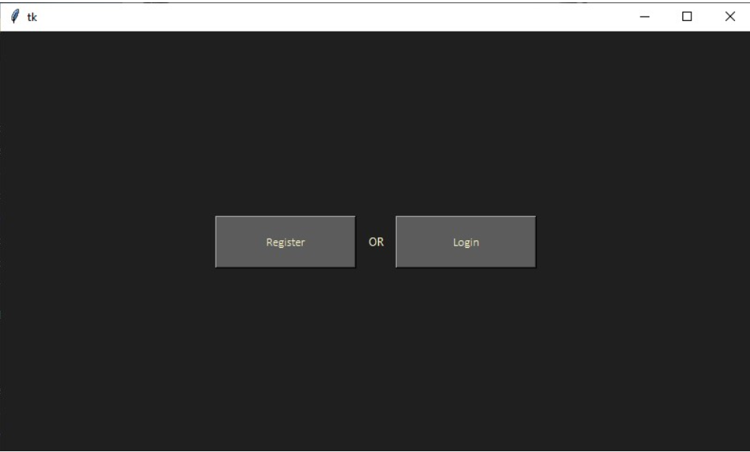
homepage

Slide 16
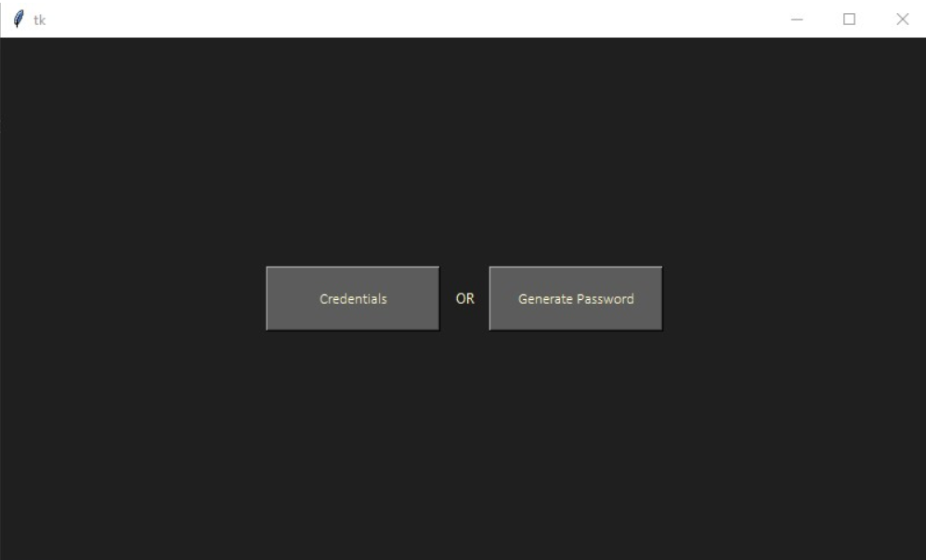
The Transition page

Slide 17
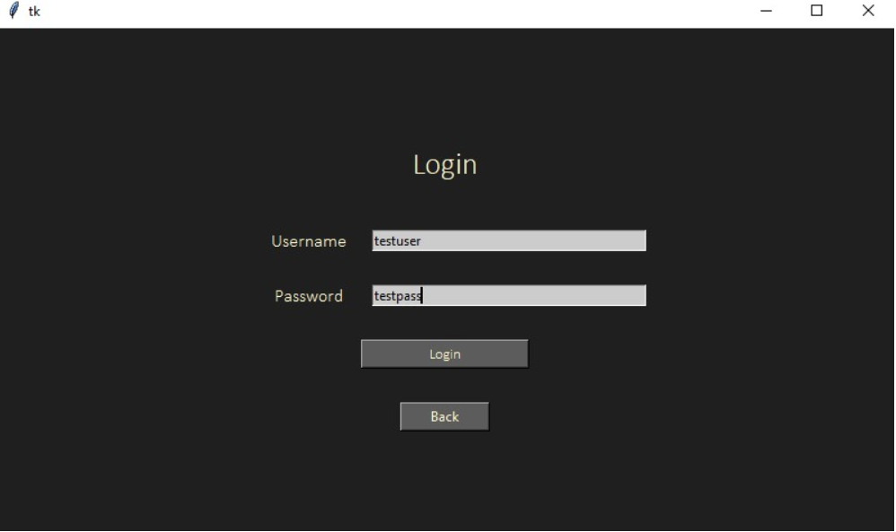
The Login page

Slide 18
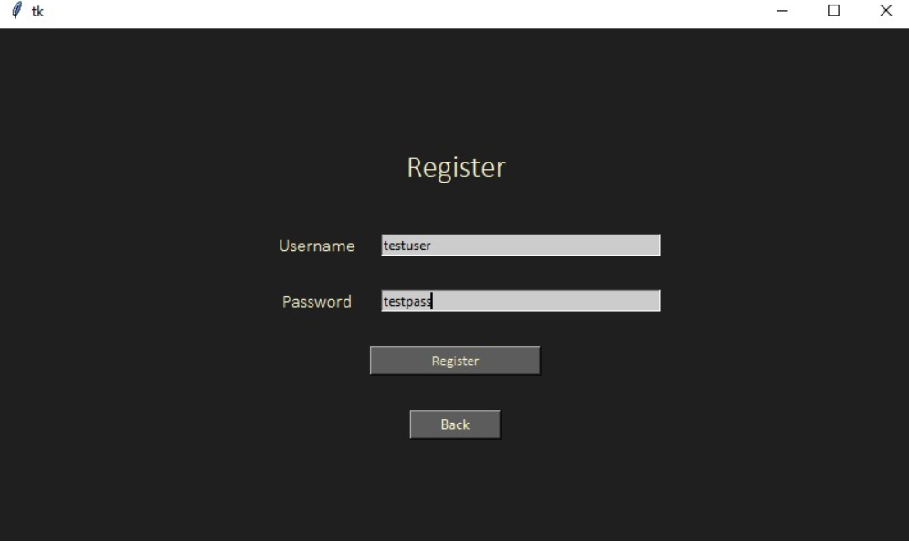
The register page

Slide 19
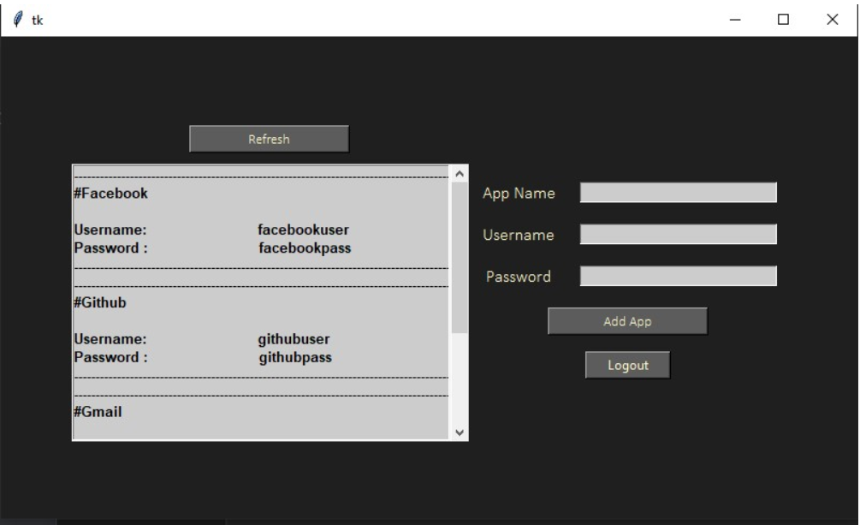
THE PASSWORD MANAGER PAGE

Slide 20
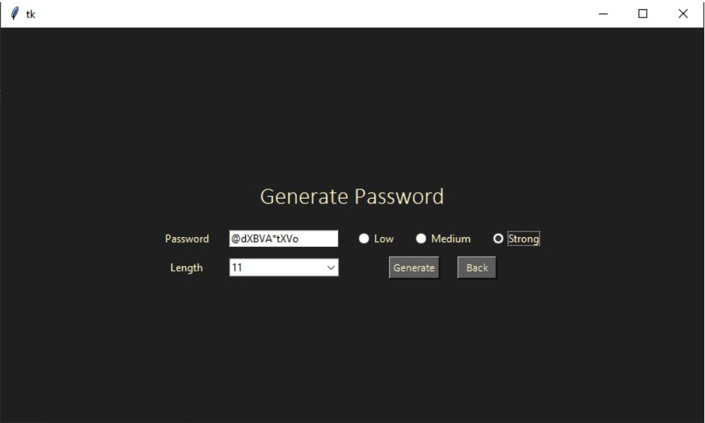
tHE PASSWORD GENERATOR PAGE

Slide 21
USER MANUAL

Slide 22
LINK OF USER MANUAL
https://drive.google.com/open?id=1V16AIPAu9fVp_1dzW3TQ7Z2wEDnqtGCP

Slide 23
DEMONSTRATION USING VIDEO

Slide 24


Slide 25
Link for video!
https://drive.google.com/file/d/1IV5BUlvg6sAu1haP51UQ6eXTM_XS1yrR/view?usp=sharing

Slide 26
REPORT

Slide 27
LINK FOR REPORT
https://drive.google.com/file/d/1dvBQS70F3vjwJQjGr8ZU7if-23Ev5RzE/view?usp=sharing

Slide 28
THANK YOU!!

